Slide 1

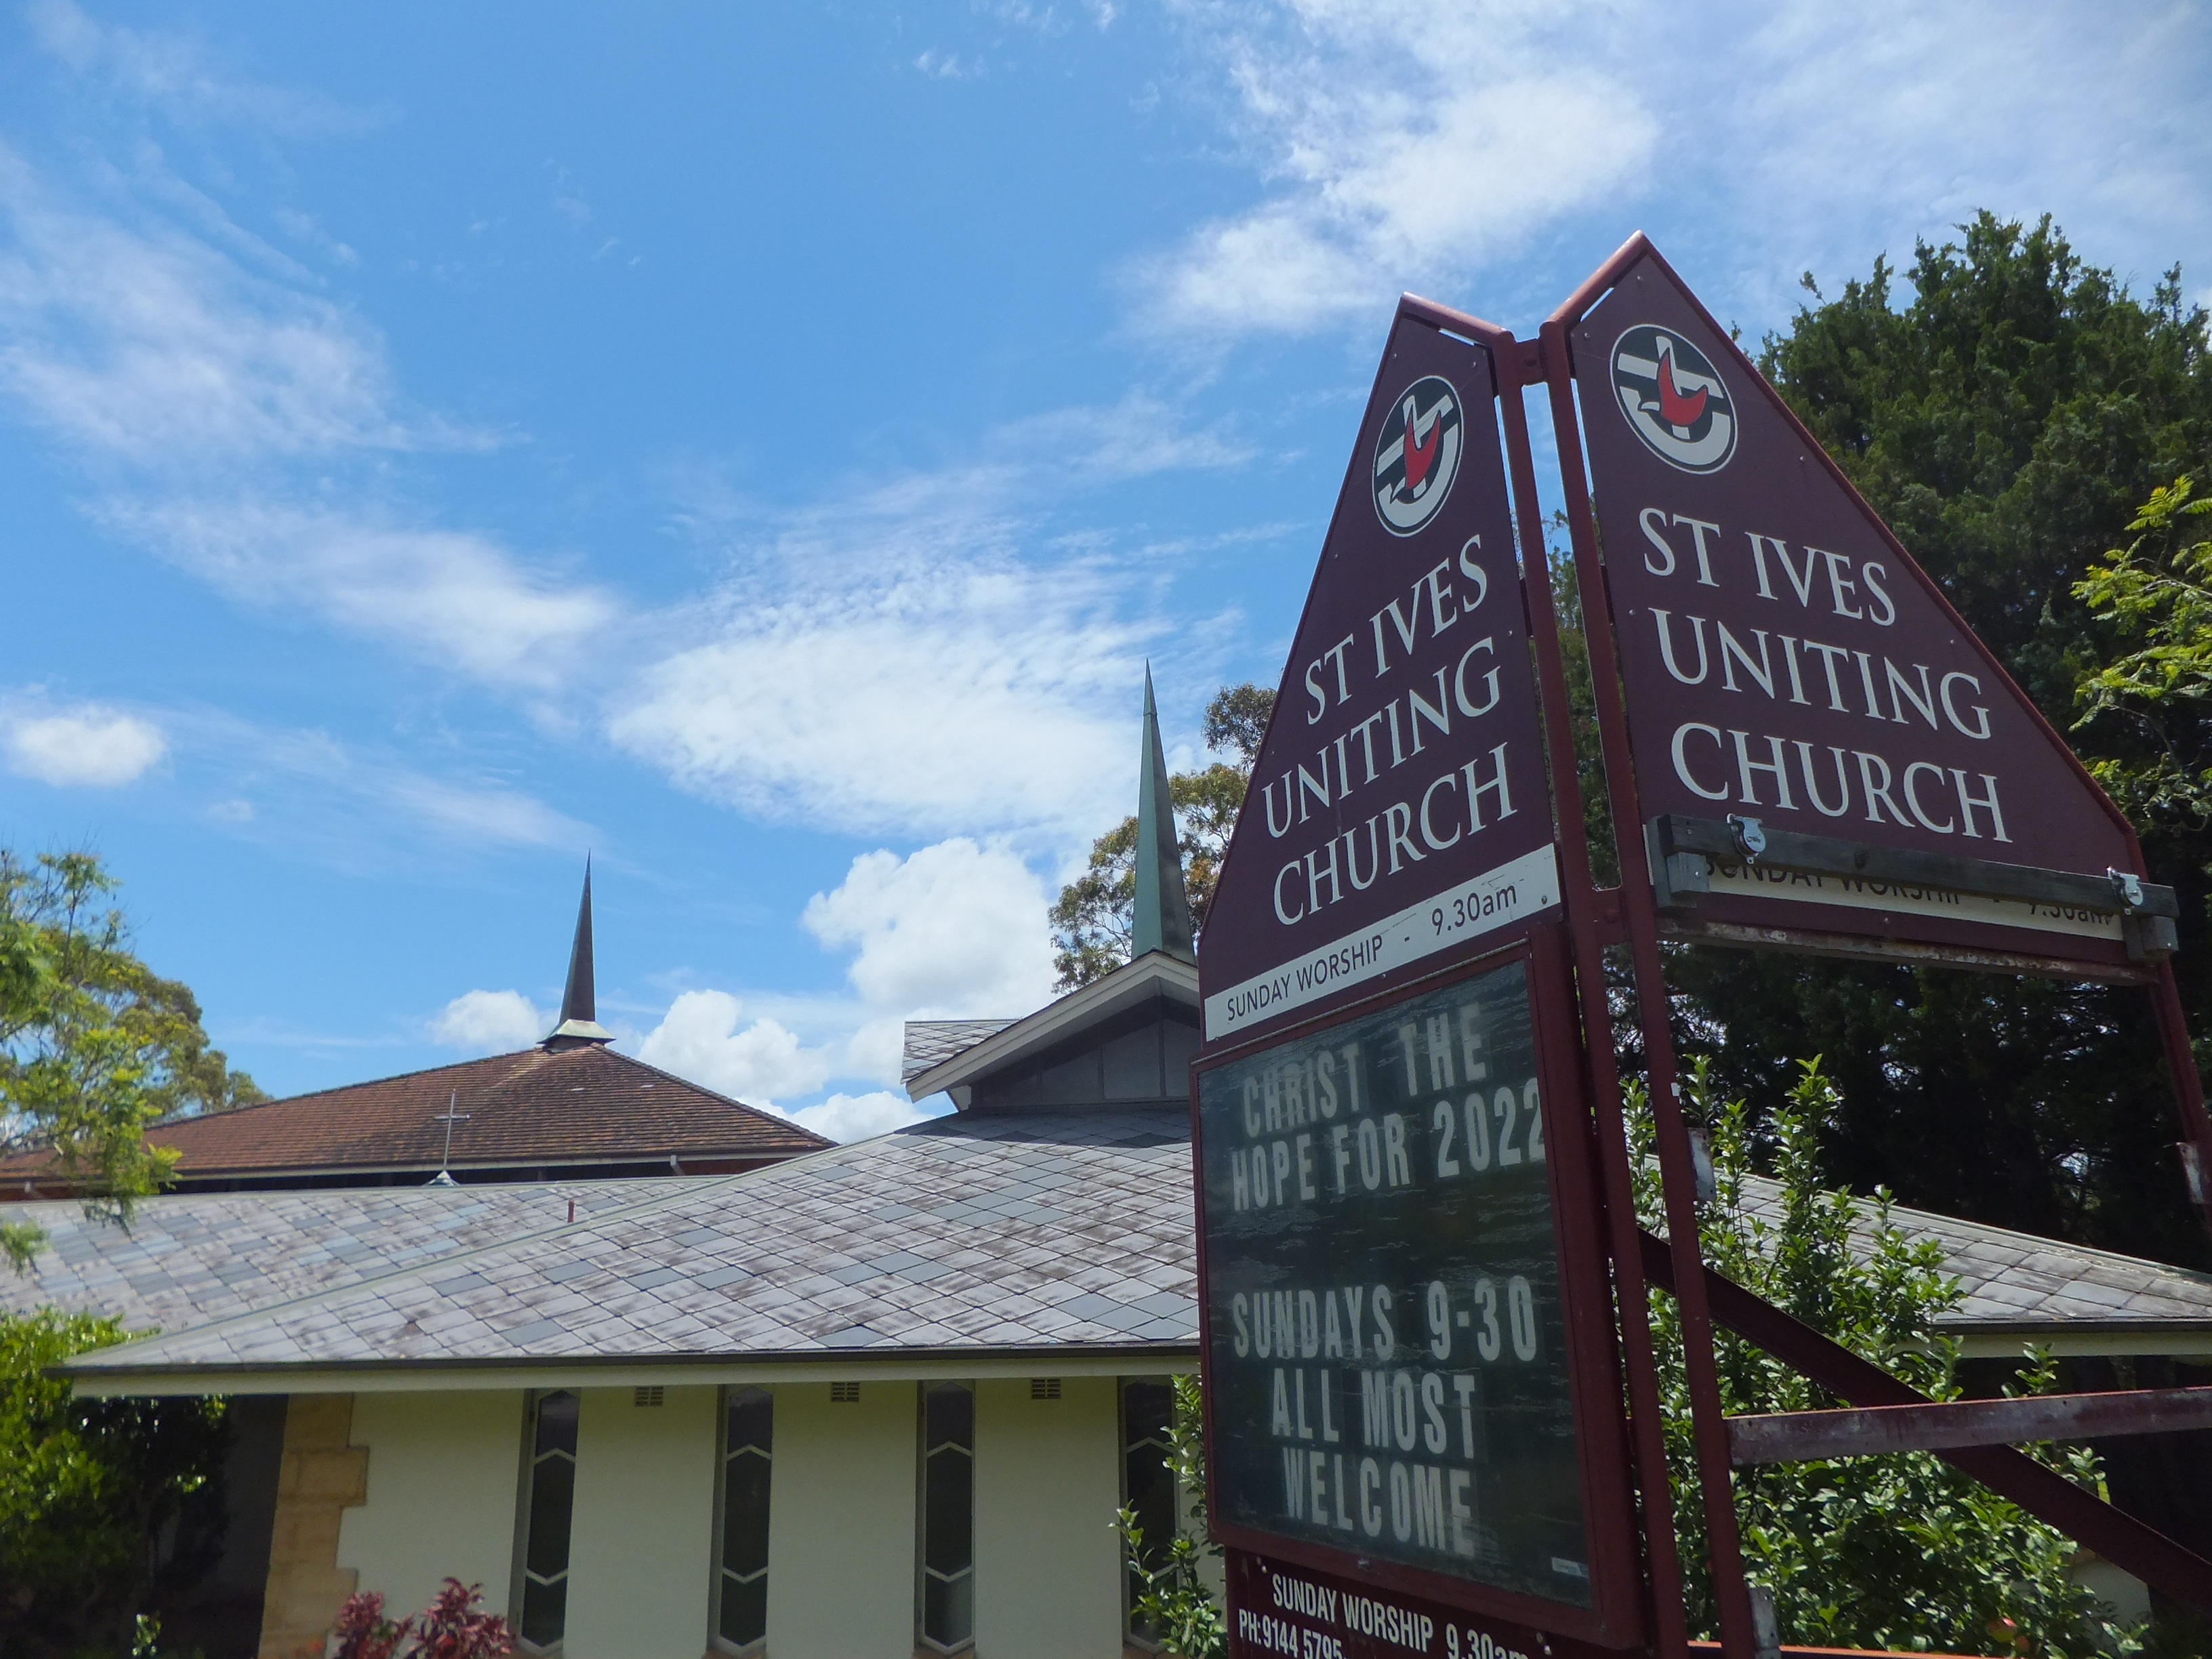
Welcome
St Ives Uniting
Morning Worship
Service Sunday January 9th 2022

Slide 2
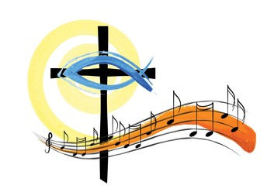
Sing to the
Lord’s Goodness

Slide 3
1. Sing of the Lord’s goodness,
Father of all wisdom,
Come to him and bless his name,
Mercy he has shown us,
His love is forever,
Faithful to the end of days.
Come then, all ye nations
Sing of your Lord’s goodness,
Melodies of praise and thanks to God
Ring out the Lord’s glory,
Praise him with your music.
Worship him and bless his name.
1/4

Slide 4
2. Power he has wielded
Honour is his garment,
Risen from the snares of death;
His word he has spoken,
One bread he has broken,
New life he gives now to all.
Come then, all ye nations
Sing of your Lord’s goodness,
Melodies of praise and thanks to God
Ring out the Lord’s glory,
Praise him with your music.
Worship him and bless his name.
2/4

Slide 5
3. Courage in our darkness,
Comfort in our sorrow,
Spirit of our God most high;
Solace for the weary,
Pardon for the sinner,
Splendour of the living God.
Come then, all ye nations
Sing of your Lord’s goodness,
Melodies of praise and thanks to God
Ring out the Lord’s glory,
Praise him with your music.
Worship him and bless his name.
3 /4

Slide 6
4. Praise him with your singing,
Praise him with the trumpet,
Praise God with the lute and harp;
Praise him with the cymbals,
Praise him with your dancing
Praise him till the end of days.
Come then, all ye nations
Sing of your Lord’s goodness,
Melodies of praise and thanks to God
Ring out the Lord’s glory,
Praise him with your music.
Worship him and bless his name.
4/4

Slide 7
First Lesson Isaiah Chapter 43 Verses 1 - 7
But now, this is what the Lord says—he who created you, Jacob,
he who formed you, Israel:
“Do not fear, for I have redeemed you; I have summoned you by name; you are mine.
² When you pass through the waters, I will be with you;
and when you pass through the rivers, they will not sweep over you.
When you walk through the fire, you will not be burned;
the flames will not set you ablaze.
³ For I am the Lord your God, the Holy One of Israel, your Saviour;
I give Egypt for your ransom, Cush^{[a]} and Seba in your stead.

Slide 8
⁴ Since you are precious and honoured in my sight, and because I love you,
I will give people in exchange for you, nations in exchange for your life.
⁵ Do not be afraid, for I am with you; I will bring your children from the east and gather you from the west.
⁶ I will say to the north, ‘Give them up!’ and to the south, ‘Do not hold them back.’
Bring my sons from afar and my daughters from the ends of the earth—
⁷ everyone who is called by my name, whom I created for my glory, whom I formed and made.”
This is the Word of the Lord
Thanks be to God

Slide 9

Through all the changing scenes of life

Slide 10
1. Through all the changing scenes of life
In trouble and in joy
The praises of my God shall still
My heart and tongue employ
2. O glorify the Lord with me
With me exalt His name
When in distress to Him I called
He to my rescue came
3. The hosts of God encamp around
The dwellings of the just
His saving help He gives to all
Who in His mercy trust
1-3/6

Slide 11
4. O taste His goodness prove His love
Experience will decide
How blessed they are and only they
Who in His truth confide
5. Hear Him you saints and you will then
Have nothing else to fear
His service shall be your delight
Your needs shall be His care
6. To Father Son and Spirit praise
To God whom we adore
Be worship glory power and love
Both now and evermore
4 – 6/6
4 – 6/6

Slide 12
Second Lesson, Luke Chapter 3 Verses 15 - 22
¹⁵ The people were waiting expectantly and were all wondering in their hearts if John might possibly be the Messiah.
¹⁶ John answered them all, “I baptize you with water. But one who is more powerful than I will come, the straps of whose sandals I am not worthy to untie. He will baptize you with the Holy Spirit and fire.
¹⁷ His winnowing fork is in his hand to clear his threshing floor and to gather the wheat into his barn, but he will burn up the chaff with unquenchable fire.”
¹⁸ And with many other words John exhorted the people and proclaimed the good news to them.

Slide 13
¹⁹ But when John rebuked Herod the tetrarch because of his marriage to Herodias, his brother’s wife, and all the other evil things he had done, ²⁰ Herod added this to them all: He locked John up in prison.
²¹ When all the people were being baptized, Jesus was baptized too. And as he was praying, heaven was opened ²² and the Holy Spirit descended on him in bodily form like a dove. And a voice came from heaven: “You are my Son, whom I love; with you I am well pleased.”
This is the Gospel of the Lord
Lord Jesus Christ we give you our praise

Slide 14

We give our offerings for God’s work

Slide 15
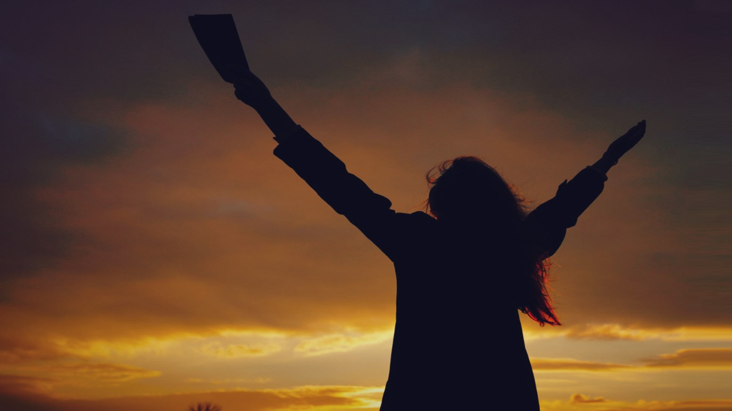
The Doxology
Praise God from whom all blessings flow,
Praise him, all creatures here below,
Praise him above, ye heavenly host,
Praise Father, Son and Holy Ghost

Slide 16

Prayers of the People
Our Father in heaven,
Hallowed be your name
Your kingdom come
Your will be done
On earth as it is in heaven.
Give us today our daily bread.
Forgive us our sins
As we forgive those who sin against us.
Save us from the time of trial
And deliver us from evil
For the kingdom, the power; and the glory are yours
Now and forever. Amen.

Slide 17
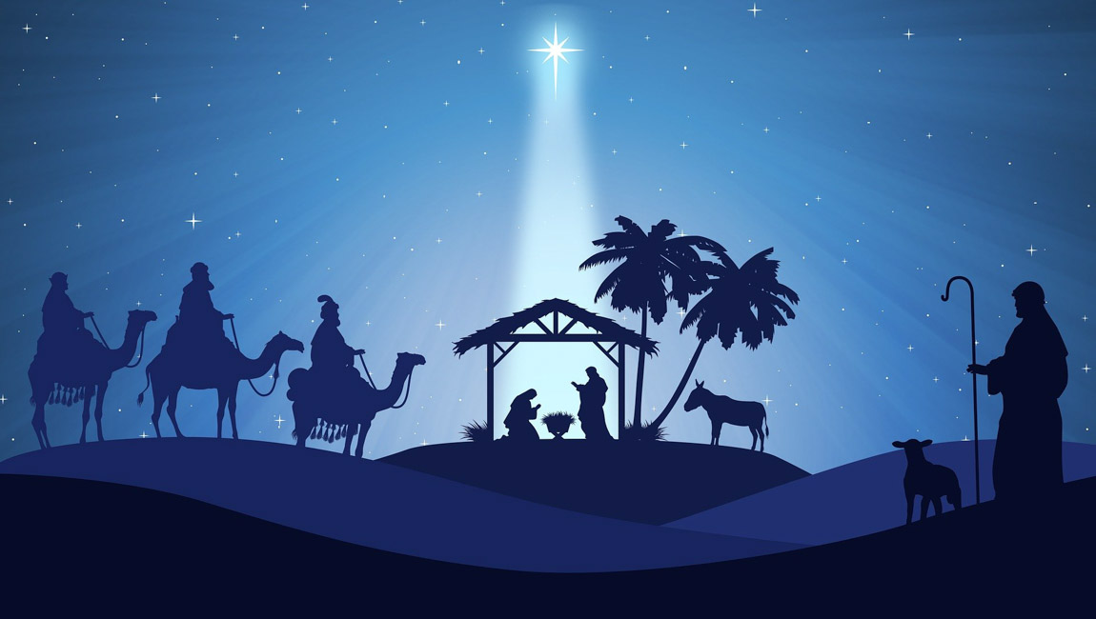
Sometimes a
light surprises

Slide 18
1. Sometimes a light surprises
The Christian while he sings
It is the Lord who rises
With healing in his wings
When comforts are declining
He grants to those in pain
A day of sunlight shining
To follow up the rain
2. In holy contemplation
We happily pursue
The theme of God's salvation
And find it every new
Set free from present sorrow
Contentedly we say
Let each unknown tomorrow
Bring with it what it may
1-2/4

Slide 19
3. The day brings with it nothing
But God will bear us through
He gives the lilies clothing
And clothes his people too
Beneath the spacious heavens
All living things are fed
And he who feeds the ravens
Will give his children bread
4. Though vine and fig tree neither
Their wonted fruit shall bear
Though all the fields should wither
And cattle not be there
Yet God is there in spirit
And praise shall tune my voice
May men and angels hear it
And know that I rejoice
3-4/4

Slide 20

Shalom to you now, Shalom my friends;
May God’s full mercies bless you my friends.
In all your living,
And through your loving,
Christ be your Shalom
Christ be your Shalom.

